Slide 1
Accommodation Crawler
Classification project
Eddy Martínez

Slide 2

Previous regression project
Predicting prices is good for both investors and tenants/buyers:
Investors can set optimum price for revenue.
Tenants/buyers know in advance the cost of the property with their desired conditions.

Slide 3

Shifting the perspective
Predicting the property type also offers benefits:
Investors know what is type of property that has best revenue with specific locations and conditions.
Tenants/buyers know what is the most accessible property type with their budget and desired location and conditions.

Slide 4
How to predict property type?
Take available data from properties
Clean and preprocess
Train different models
Optimize all models
Select the best

Slide 5
Available data
Features
Label
Desired conditions
Price
Includes bills with rent (if rental)
Area
Number of bedrooms
Number of bathrooms
Number of receptions
Furnished
Shared
Student
Location
Longitude
Latitude
Property type
Splitting
Train / Validation / Test
Normalizing

Slide 6
GridSearch
Search over different hyperparameters combinations for each model:
Logistic Regression:
No penalty
KNN Classifier:
14 Neighbours
Weights by inverse distance
Decision Tree Classifier:
Entropy as criterion
1 min sample leaf
2 min samples split
0 min weight fraction leaf
Random Forest Classifier:
Bootstrap
0 CCP_Alpha
Class_weight balanced_subsample
Gini as criterion
1 min sample leaf
2 min samples split
0 min weight fraction
130 estimators
OOB Score

Slide 7
GridSearch
NeuralNetClassifier with SGD:
lr 0.1
batchnorm True
dropout p = 0
4 hidden layers
damp = 0
momentum = 0.1
weight_decay = 0

Slide 8
Results
Best Model: Random Forests
Parameters:
num_of_estimators: 100
min_samples_leaf: 8,
min_samples_split: 5,
min_weight_fraction_leaf: 0.0
Score (R squared):
Training score: 0.51,
Validation score: 0.27,
Test score: 0.52

Slide 9
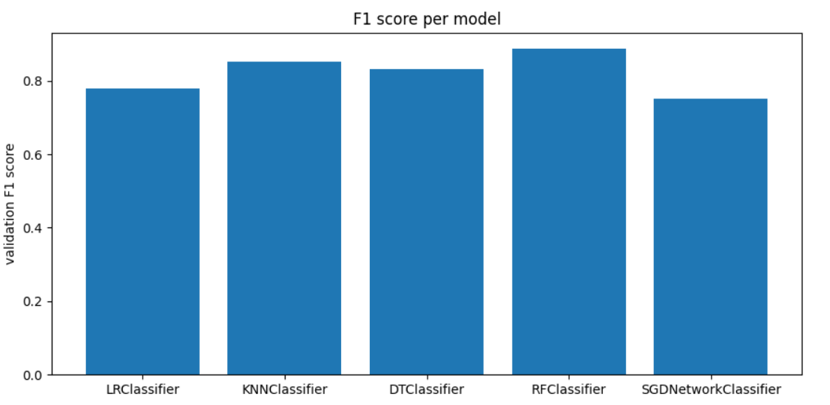
Validation Score

Slide 10
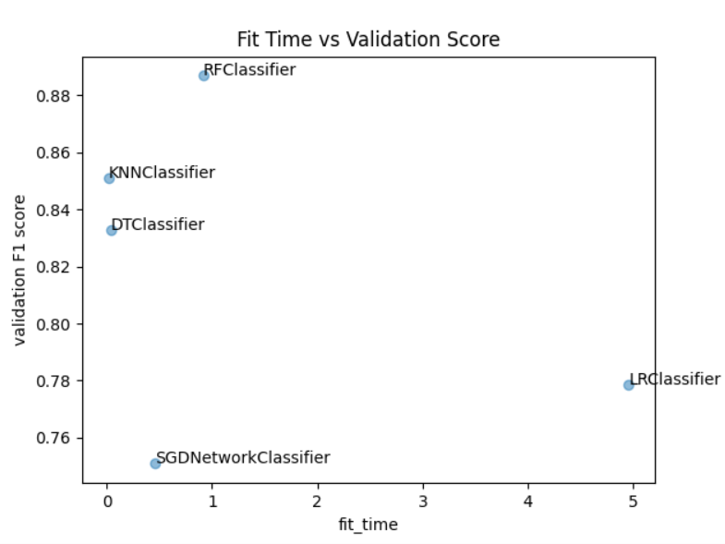
Fit time vs. Validation Score

Slide 11
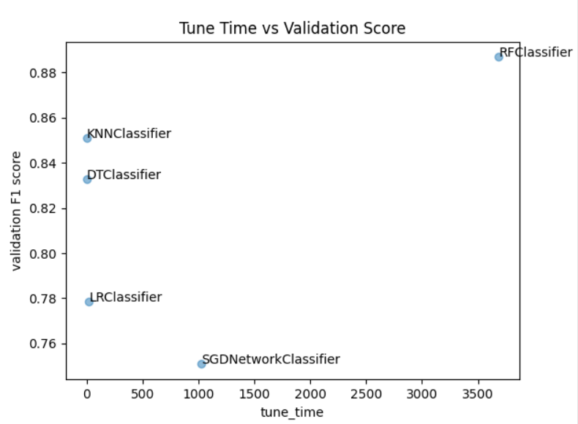
Tuning time vs. Validation Score

Slide 12
Mistakes/Opportunities
Using Skorch for Sklearn API
Sklearn doesn’t work on GPU
Might achieve better results work better with MLFlow or Ray Tune

Slide 13
Questions / Recommendations

